Slide 1
SOFTWARE ENGINEERING

Slide 2
Software testing
Software Testing is a method to check whether the actual software product matches expected requirements and to ensure that software product is Defect free. It involves execution of software/system components using manual or automated tools to evaluate one or more properties of interest. The purpose of software testing is to identify errors, gaps or missing requirements in contrast to actual requirements.

Slide 3
Principles of testing
Testing shows the presence of defects.
Exhaustive testing is not possible.
Early testing.
Defect clustering.
Pesticide paradox.
Testing is context-dependent.
Absence of errors fallacy.

Slide 4
Verification and Validation
Verification:
Verification is the process of checking that a software achieves its goal without any bugs. It is the process to ensure whether the product that is developed is right or not. It verifies whether the developed product fulfills the requirements that we have. Verification is static testing.
Validation:
Validation is the process of checking whether the software product is up to the mark or in other words product has high level requirements. It is the process of checking the validation of product i.e. it checks what we are developing is the right product. it is validation of actual and expected product. Validation is the dynamic testing.

Slide 5
Testing strategies.
Software Testing is a type of investigation to find out if there is any default or error present in the software so that the errors can be reduced or removed to increase the quality of the software and to check whether it fulfills the specifies requirements or not.
According to Glen Myers, software testing has the following objectives:
The process of investigating and checking a program to find whether there is an error or not and does it fulfill the requirements or not is called testing.
(II) When the number of errors found during the testing is high, it indicates that the testing was good and is a sign of good test case.
(III) Finding an unknown error that’s wasn’t discovered yet is a sign of a successful and a good test case.

Slide 6
Basis Path Testing: -
The basis path testing is same, but it is based on a White Box Testing method, that defines test cases based on the flows or logical path that can be taken through the program. Basis path testing involves execution of all possible blocks in a program and achieves maximum path coverage with least number of test cases. It is a hybrid of branch testing and path testing methods.
The objective behind basis path testing is that it defines the number of independent paths, thus the number of test cases needed can be defined explicitly (maximizes the coverage of each test case).

Slide 7
Here we will take a simple example, to get better idea what is basis path testing include.
In the above example, we can see there are few conditional statements that is executed depending on what condition it suffice.
Here there are 3 path or condition that need to be tested to get the output,
• Path 1: 1,2,3,5,6, 7
• Path 2: 1,2,4,5,6, 7
• Path 3: 1, 6, 7

Slide 8
Levels of Testing:
Testing any application or software, the test engineer needs to follow multiple testing techniques.
In order to detect an error, we will implement software testing; therefore, all the errors can be removed to find a product with more excellent quality.
Different Levels of Testing:
In software testing, we have four different levels of testing, which are as discussed below:
Unit Testing
Integration Testing
System Testing
Acceptance Testing

Slide 9
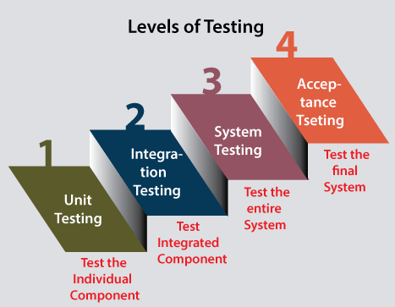

Slide 10
Level 1: Unit Testing
Unit testing is the first level of software testing, which is used to test if software modules are satisfying the given requirement or not.
Unit testing will help the test engineer and developers in order to understand the base of code that makes them able to change defect causing code quickly. The developers implement the unit.
Level 2: Integration Testing
The second level of software testing is the integration testing. The integration testing process comes after unit testing.
It is mainly used to test the data flow from one module or component to other modules.
In simple words, we can say that integration testing aims to evaluate the accuracy of communication among all the modules.

Slide 11
Level 3: System Testing
The third level of software testing is system testing, which is used to test the software's functional and non-functional requirements.
It is end-to-end testing where the testing environment is parallel to the production environment. In the third level of software testing, we will test the application as a whole system.
Level 4: Acceptance Testing
The last and fourth level of software testing is acceptance testing, which is used to evaluate whether a specification or the requirements are met as per its delivery.
The software has passed through three testing levels (Unit Testing, Integration Testing, System Testing). Some minor errors can still be identified when the end-user uses the system in the actual scenario.
The acceptance testing is also known as User acceptance testing (UAT) and is done by the customer before accepting the final product.

Slide 12
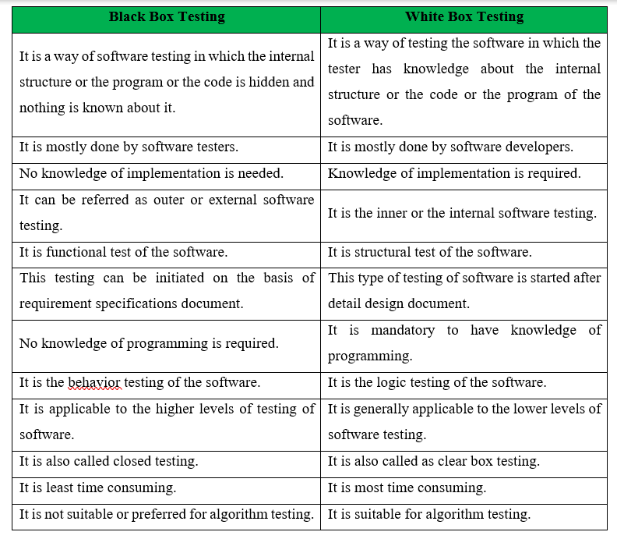

Slide 13
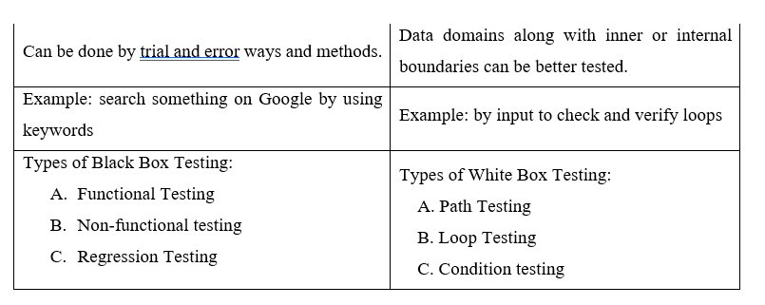

Slide 14
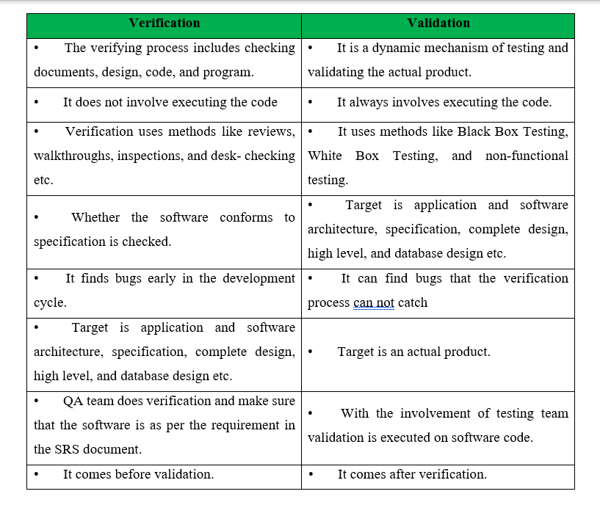

Slide 15
Debugging:
Debugging works stepwise, starting from identifying the errors, analyzing followed by removing the errors. Whenever a software fails to deliver the result, we need the software tester to test the application and solve it.
Here is a list of some of the widely used debuggers:
Radare2
WinDbg
Valgrind

Slide 16
Benefits of Debugging:
Debugging can immediately report an error condition whenever it occurs. It prevents hampering the result by detecting the bugs in the earlier stage, making software development stress-free and smooth.
It offers relevant information related to the data structures that further helps in easier interpretation.
Debugging assist the developer in reducing impractical and disrupting information.
With debugging, the developer can easily avoid complex one-use testing code to save time and energy in software development.

Slide 17
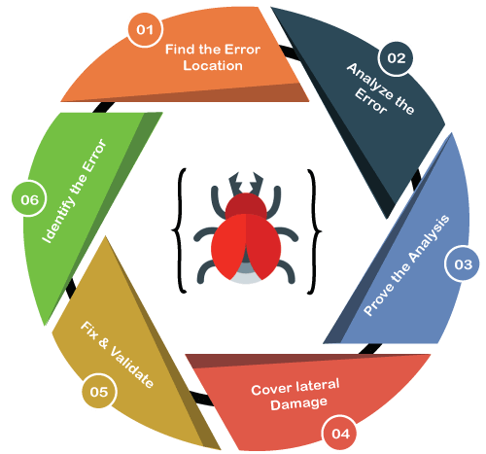
Steps involved in Debugging:
Following are the different steps that are involved in debugging:
Identify the Error: Identifying an error in a wrong may result in the wastage of time. Thus, it is mandatory to identify the actual error.
Find the Error Location: Once the error is correctly discovered, you will be required to thoroughly review the code repeatedly to locate the position of the error.
Analyze the Error: The third step comprises error analysis, a bottom-up approach that starts from the location of the error followed by analyzing the code. This step makes it easier to comprehend the errors.

Slide 18
Prove the Analysis: After analyzing the primary bugs, it is necessary to look for some extra errors that may show up on the application. By incorporating the test framework, the fourth step is used to write automated tests for such areas.
Cover Lateral Damage: The fifth phase is about accumulating all of the unit tests for the code that requires modification. As when you run these unit tests, they must pass.
Fix & Validate: The last stage is the fix and validation that emphasizes fixing the bugs followed by running all the test scripts to check whether they pass.

Slide 19
